Slide 1
Andover Community Power (ACP) Information Session
April 12, 2024
Zoom
Joyce Losick-Yang

Slide 2
Municipal Aggregation
+
kWh
Municipal
Town Hires Energy Consultant
Town Competitively Selects Electricity Supplier
Community Designs Program
Aggregation
Many Retail Accounts Combined Into Single
Wholesale Purchase

Slide 3
Electricity System
The utility manages the delivery portion (wires and poles)
For Andover, National Grid is the utility
1. Delivery: the wires that get power to you
National grid provides supply by default, called Basic Service. Customers can choose their own supplier and leave Basic Service at any time
Most residential and small business accounts are still on basic service, while most large commercial accounts have chosen their own supplier
2. Supply: the actual electricity

Slide 4
Timeline to Date
Sep ‘20- Approval of voters at Town Meeting
Oct ‘20- Selected consultant to help develop a plan
Nov ‘20 – Jun ‘21 Draft plan developed by local design team
May - Jun ’21 - Public commenting period on draft plan
Jul ‘21 - Approval of plan by Select Board
Jul ‘21 – Jan ‘24 - Department of Public Utilities review
Feb – Mar ’24 - Issued a competitive bid; selected Dynegy as the ACP electricity supplier!
Mar – May ’24 – Engage with the community
Jun ‘24 - Launch program

Slide 5
Benefits of Municipal Aggregations
Rate Stability
Utilities are restricted in how they procure Basic Supply Service which leads to pricing spikes, often in the winter. Aggregations typically contract for 2 to 3 years at a fixed rate providing predictability and stability for budgeting.
Local Renewable
Program allows Andover to purchase energy with a higher renewable content than required. Local renewable energy leads to job creation and stimulate investments in New England. Not all clean energy is created equal.
Potential Savings
Aggregation allows for securing competitive pricing through bulk purchasing and to time the Town’s bid to avoid bad markets and lock in good prices. Although not guaranteed, residents typically see savings over the life of the contract. Focus needs to be on long term savings.
IMPORTANT DISCLAIMER: The ACP program seeks to provide price stability and average savings over the duration of the program, but because future Basic Service rates are not known, there is no guarantee of savings.

Slide 6
Historic National Grid Basic Service Rates
IMPORTANT DISCLAIMER: The ACP program seeks to provide price stability and average savings over the duration of the program, but because future Basic Service rates are not known, there is no guarantee of savings.
Basic Service (cents per kilowatt-hour)
Period
Average
16.375
2023
Average
24.00
2022
Average
13.15
2021
Average
11.05
Winter
2021
Summer
2021
Winter
2022
Summer
2022
Winter
2023
Summer
2023
Winter
2024

Slide 7
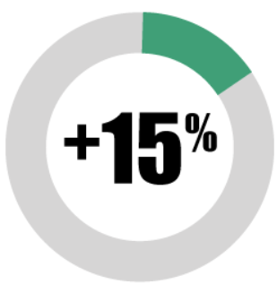
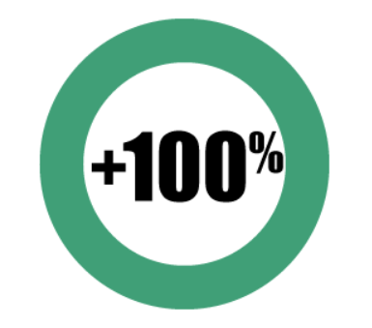
Andover Community Power Plan Options
 | Basic Service (Residential) | Andover Basic | Andover Standard (automatic for eligible customers) | Andover Ultimate
Price | 18.213 ¢/kWh | 13.286 ¢/kWh | 13.905 ¢/kWh | 14.637 ¢/kWh
Voluntary Renewable Energy* | None | None | + 15% voluntary renewable energy (MA Class I RECs) | Adds voluntary renewable energy (MA Class I RECs) to 100%
Duration | Nov 1, 2023 - Jul 31, 2024 | June 2024 - December 2027 | June 2024 - December 2027 | June 2024 - December 2027
IMPORTANT DISCLAIMER: The ACP program seeks to provide price stability and average savings over the duration of the program, but because future Basic Service rates are not known, there is no guarantee of savings.

Slide 8
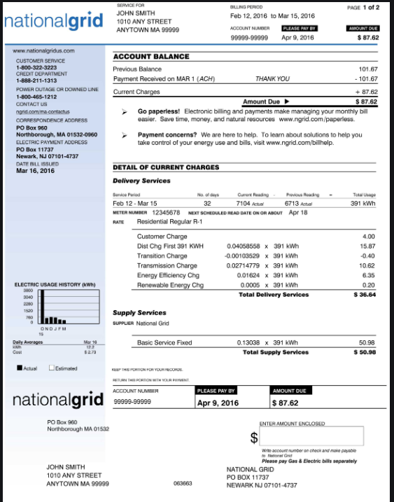
Electricity Bill for June 2024
What stays the same:
Billing/metering still done by National Grid
Single bill
Same customer service charge of $7/month
Same delivery rate of $0.168/kWh
What will be different:
Supply services from ACP Dynegy
Supply rate of $0.139/kWh vs. $0.182/kWh
Supply rate stays the same for August and beyond
900 kWh/Month Residential Electric Utility Cost | On Andover Standard | On NGRID Basic Service
Customer Service | $7.00 | $7.00
Delivery | $151.20 | $151.20
Supply | $125.10 | $163.80
Total | $283.30 | $322.00
IMPORTANT DISCLAIMER: The ACP program seeks to provide price stability and average savings over the duration of the program, but because future Basic Service rates are not known, there is no guarantee of savings.

Slide 9
How Andover Community Power Program Differs From Third Party Electricity Supplier
 | Individual 3rd Party Supplier | Andover Community Power
Door to Door Solicitations | Maybe | Never
Mailers | Often | One postcard and one letter per contract term
Early Termination Fee | Maybe | Never
Variable Pricing | Often | Never

Slide 10
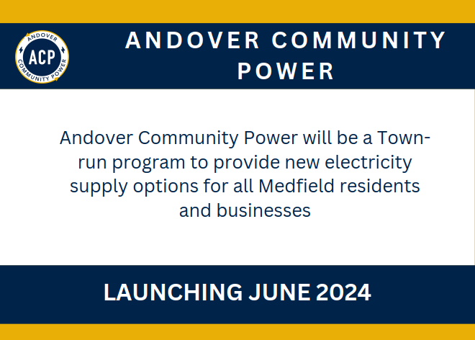
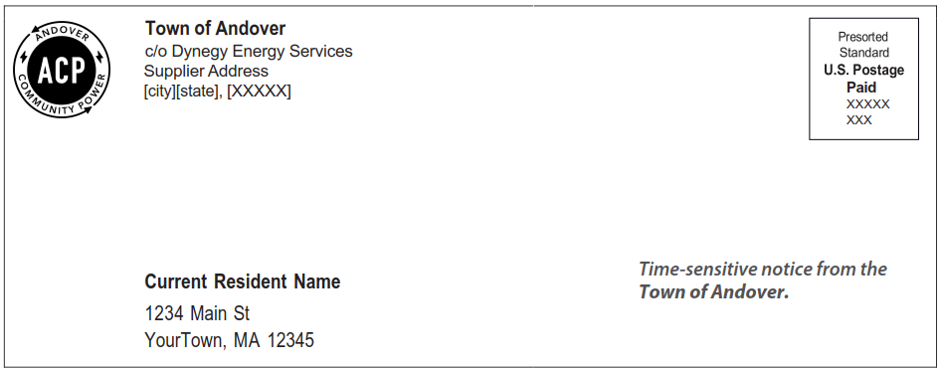
Official Postcard
Official
Opt-Out Mailer

Slide 11
Other Planned ACP Engagements
Mar – May ’24 – Community Meetings
Tuesday, March 26, 1:30 PM, Robb Senior Center
Monday, April 8, 9:00 AM, Old Town Hall
Friday, April 12, 12noon, virtual Zoom meeting (will be recorded)
Wednesday, April 17, 6:00 PM, Memorial Hall Library
April 2 - Official Press Release; Website Updated; Customer service line up
April 10 –Official Mailer sent
May 13 – Opt-out/Opt-up period ends
June - Launch program

